Slide 1

CoAssist: Shout Out for Help Solution
- Language friendly Remote Assistance

Slide 2



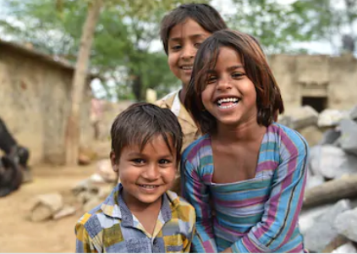

Shout out for Help App

Slide 3

Idea Description –Shout out for Help App
This solution is to assist citizens who are not tech savvy, have access to mobile phones or are conversant with English.
We could install a small device like a Raspberry Pi in areas like slums, shanties, working class citizens’ residences. NGOs or health workers may not be able to personally visit such locations, or would not be aware of the needs of the people. The Raspberry pi could be attached to a microphone and a speaker device.
When someone is in need of food, medicine, health support, guidance etc., they could come to this device and talk in any language known to them. A speech to text converter app on the raspberry pi would convert the spoken content to text. This text would be sent to an IoT platform which will store the details in a portal. Based on the nature of the request and location, the request will be directed to an NGO, supporting organization close to the requestor. Once the request is addressed, the NGO worker could close the request through their mobile application.
A text to speech application can also be installed on the Raspberry Pi to provide guidance to citizens in a language of their choice.
A CCTV attached to the Raspberry Pi device can detect surrounding locations and raise an alarm in cases of crowd gathering, or not following social distancing norms. A deep learning model can be developed on the cloud and pushed to the various Raspberry Pi devices in different locations using a CICD pipeline.
A web application on the cloud can be designed to record the various requests by citizens, updates by NGOs/health workers, COVID cases per location, common requests, risks etc.

Slide 4
Architecture Steps
The user visits the device “CoAssist” with COVID-19 solution and asks a question or makes a request.
The speech to text converter application on the “CoAssist” device converts the content to text.
This text, users name and location is sent to an IoT or Cloud platform
A web application “COVID Support” records the text and user details and location
Based on the nature of the request, a workflow directs the request to concerning authority and sends an email
Once the request is addressed, the status is marked as Closed and nature of resolution in the web application “COVID Support”
A text to speech application on the “CoAssist” device could be used to pass important messages to the locals to follow social distancing, health care guidelines and important phone numbers to dial for urgent support.
The web application can display dashboards to detect most common requests in different locations, estimated time to respond, degree of COVID impact, most common health concerns, citizen mental health etc.
The web application can provide details which can be used by supporting organizations, health workers to reach out to a wider set of citizens and monitor the progress of open items.
A CCTV camera attached to the “CoAssist” device records the surrounding location
A deep learning algorithm “CoDetect” is written using AWS sagemaker to detect crowding, social distancing
The algorithm is deployed to “CoAssist” device using AWS CICD pipeline
The device raises an alarm to warn people when social distancing violations are recorded by the CCTV device

Slide 5












Architecture Diagram
Real time streaming using IP camera
CICD Pipeline to push ML model to edge device
Raise Alarm
Crowd
CoDETECT
ML model
Internet
Watson
IoT
Text to Speech
Access Web Application
Web Application
Video Analytics
Cloud
COASSIST IoT Device
Mobile App
User
Speech to Text
NGO/ Health Worker

Slide 6









CoDetect Workflow Diagram
CoDetect
Remote Location
Cloud
Media player to stream the live feed
Opencv used to display the real time output
Results from Inference processing
Real time streaming using IP camera
ML Model
Amazon Sagemaker
ML Model
AWS Greengrass
Trained ML model
Crowd Detection
Displaying crowd analysis from IP camera live feed

Slide 7
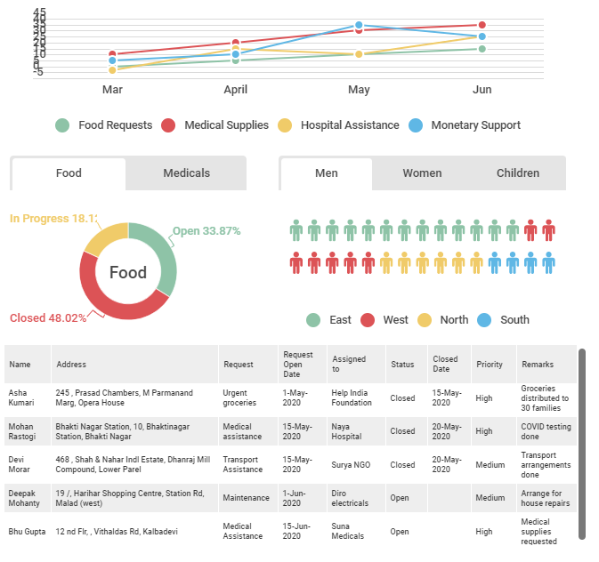
Dashboards
Name | Address | Request | Request Open Date | Assigned to | Status | Closed Date | Priority | Remarks
Asha Kumari | 245 , Prasad Chambers, M Parmanand Marg, Opera House | Urgent groceries | 1-May-2020 | Help India Foundation | Closed | 15-May-2020 | High | Groceries distributed to 30 families
Mohan Rastogi | Bhakti Nagar Station, 10, Bhaktinagar Station, Bhakti Nagar | Medical assistance | 15-May-2020 | Naya Hospital | Closed | 20-May-2020 | High | COVID testing done
Devi Morar | 468 , Shah & Nahar Indl Estate, Dhanraj Mill Compound, Lower Parel | Transport Assistance | 15-May-2020 | Surya NGO | Closed | 20-May-2020 | Medium | Transport arrangements done
Deepak Mohanty | 19 /, Harihar Shopping Centre, Station Rd, Malad (west) | Maintenance | 1-Jun-2020 | Diro electricals | Open |  | Medium | Arrange for house repairs
Bhu Gupta | 12 nd Flr, , Vithaldas Rd, Kalbadevi | Medical Assistance | 15-Jun-2020 | Suna Medicals | Open | null | High | Medical supplies requested

Slide 8
Solution Benefits
CoASSIST
CoDETECT
Reach remote sections of society to understand needs of the common people
Assist citizens who have no access to phone and/or have language barriers
Enable NGOs, Health workers to reach out to larger community
Automated workflows to reach out to right authority to address requests
Provide area wise visibility into citizens needs, health, support mechanisms
Provide guidance to citizens on important phone numbers, nearby hospitals, urgent medicines etc.
The device can be further enhanced to enable citizens to make video calls and talk to helplines, report concerns etc.
Detect Social Distancing Violations and enable guidance
Alerts for criminal activities
Detect crowding and educate citizens to follow guidelines

Slide 9
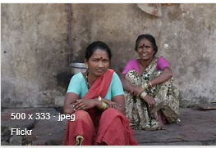
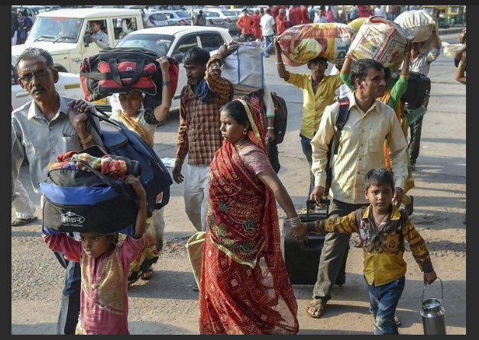

Benefits of idea
Shout out for Help App
1
Allows people in remote area to connect
3
Serve Migrants and stranded people who are on road ,if device has been placed in all Bus depot of country
2
NGO can benefit by reaching right people

Slide 10
Thank You

